Slide 1


Basic Programming using C++
by Aqilah Rose

Slide 2
“Your best quote that reflects your approach… “It’s one small step for man, one giant leap for mankind.”
- Neil Armstrong

Slide 3
Outline
Introduction
Basic
C++ features
C++
Compiler
First Program
Hello world
Variables &
their types
Data
Types
Operators
in C++
Control Statement
Functions
Functions
in c++
Default
Arguments
C++
Recursion
If, if..else-if
Switch case in C++
Array
For Loop
While Loop
1D N 2D
Passing
Array to fc
C++ Strings
Do While Loop
Continue Statement
Pointers
Break Statement
goto statement
Pointers in C++
this pointer

Slide 4
Outline (Cont.)
Object Oriented Programming (OOP) Concept
OOP Concepts
Constructor
Destructor
Structure
How to Pass & return struct from function
Enumeration
Inheritance
Polymorphism
Function Overloading
Function Overriding
Virtual Function: Run time Polymorphism
Encapsulation
Abstraction
Interfaces-Abstract Class
Pass & Return Obj from Fc
Friend Class & Function

Slide 5
INTRODUCTION

Slide 6
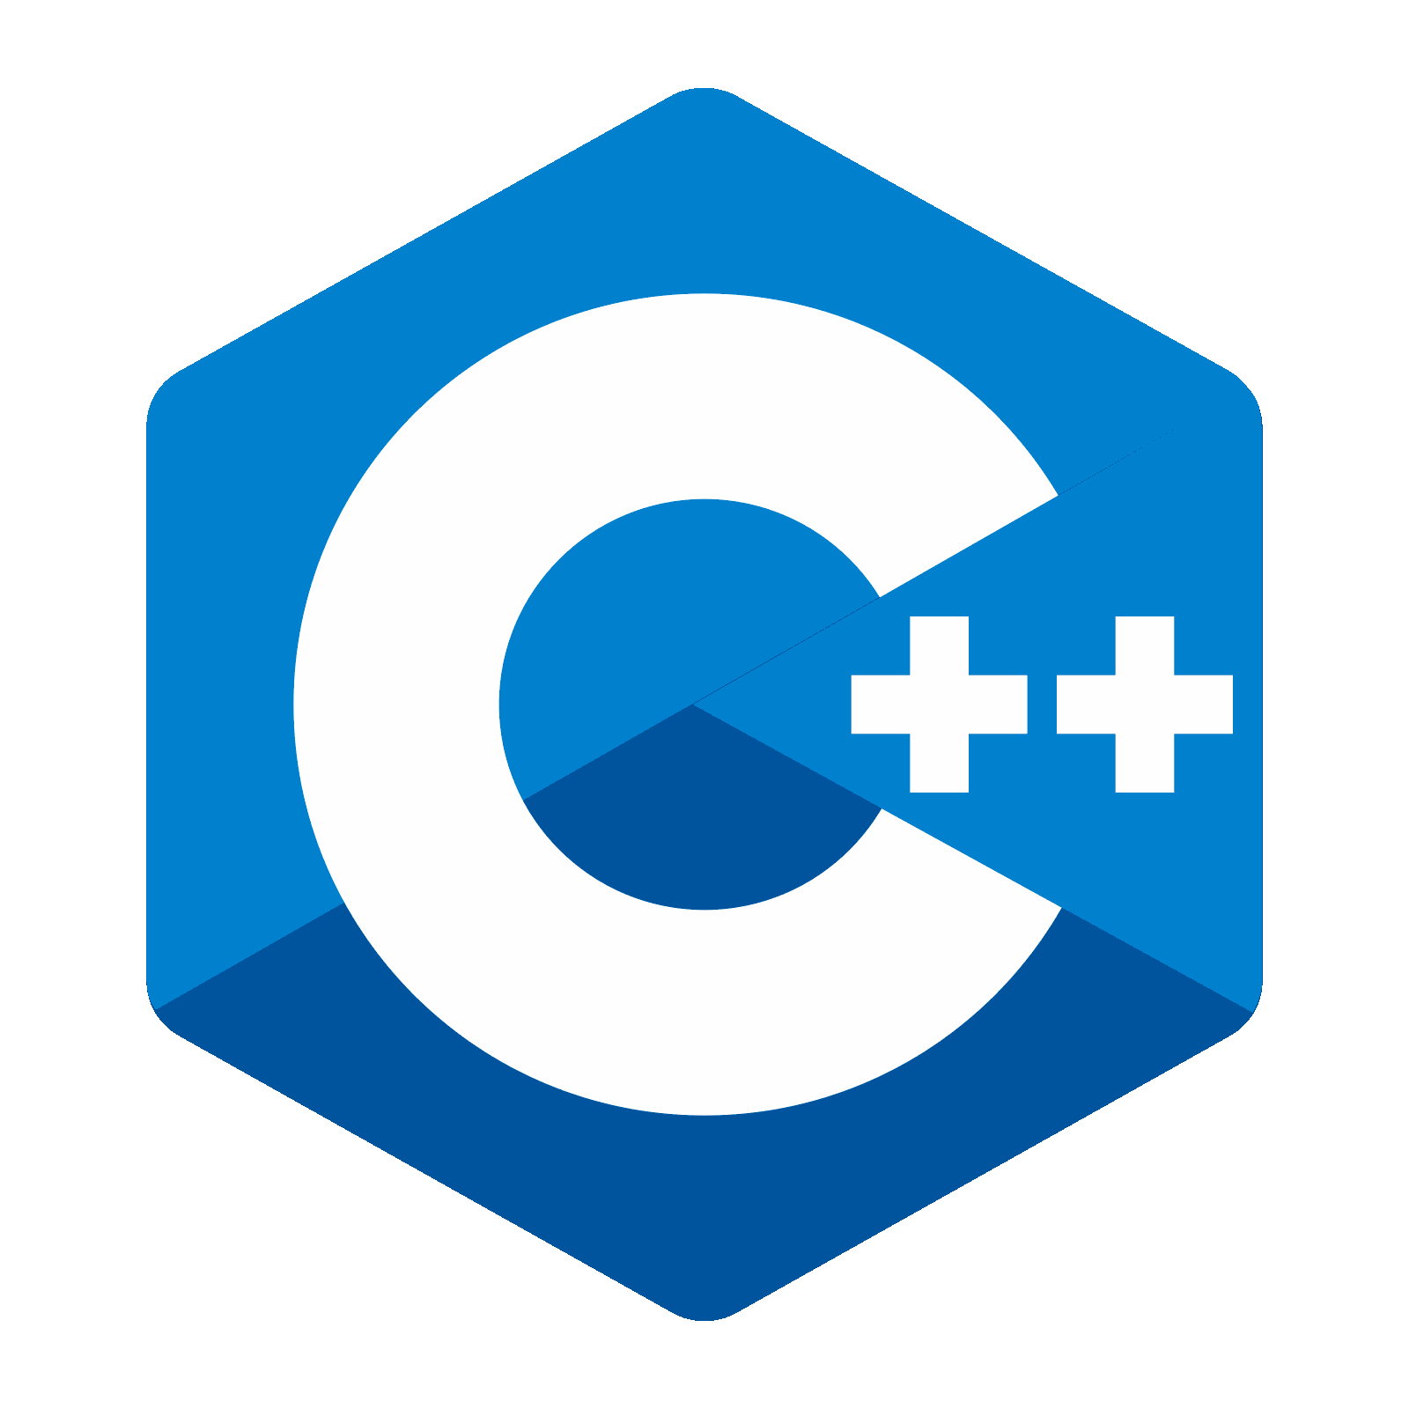
Features of C++
Better memory management – an dynamically allocate memory during runtime
Object Oriented
– have OOPs concepts, these features make writing code in C++ a lot easier.
Portable – the code you write on one operating system can be run on other Operating system, limitation; no GUI for c++
Structured Programming –have functions, easier to break a problem into small blocks of code to improves readability and reusability.
Exception handling
– Just like JAVA we can do exception handling in C++ which makes it easier to identify and handle the exceptions.
Simple– it is easier to write a program in C++. Once you get familiar with the syntax of C++ programming language, it becomes a lot easier to code in C++

Slide 7
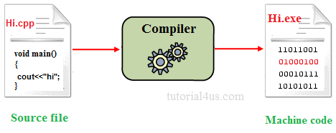
Compiler (Install c++)
Installer/Compiler : https://sourceforge.net/projects/orwelldevcpp/

Slide 8
Background of C++
The source code for a C++ (or C) program contained in a number of text files called source files.
Very simple programs might be contained within a single source file, but as our programs grow larger and more complicated, programmers try to keep things manageable by splitting the code into multiple source files.
There are two different kinds of source files: header files and compilation units. Header files are generally given names ending in “.h”.
Compilation unit files are generally given names ending in “.cpp” for C++ code and “.c” for C code.

Slide 9
Background of C++
There are variations of these file extensions, particularly for C++. Other less common endings accepted by some C++ compilers for non-header files include “.C” “.cc” and “.cxx”.
Header and non-header (compilation unit) files are treated differently when we build programs. Each compilation unit is compiled separately from the others .
This helps keep the compilation times reasonable, particularly when we are fixing bugs in a program and may have changed only one or two non-header files. Only those changed files need to be recompiled.

Slide 10
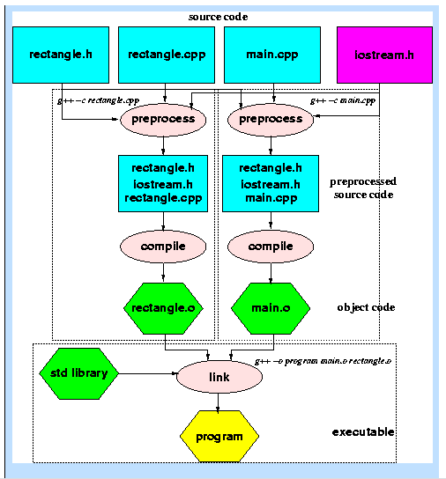

Slide 11
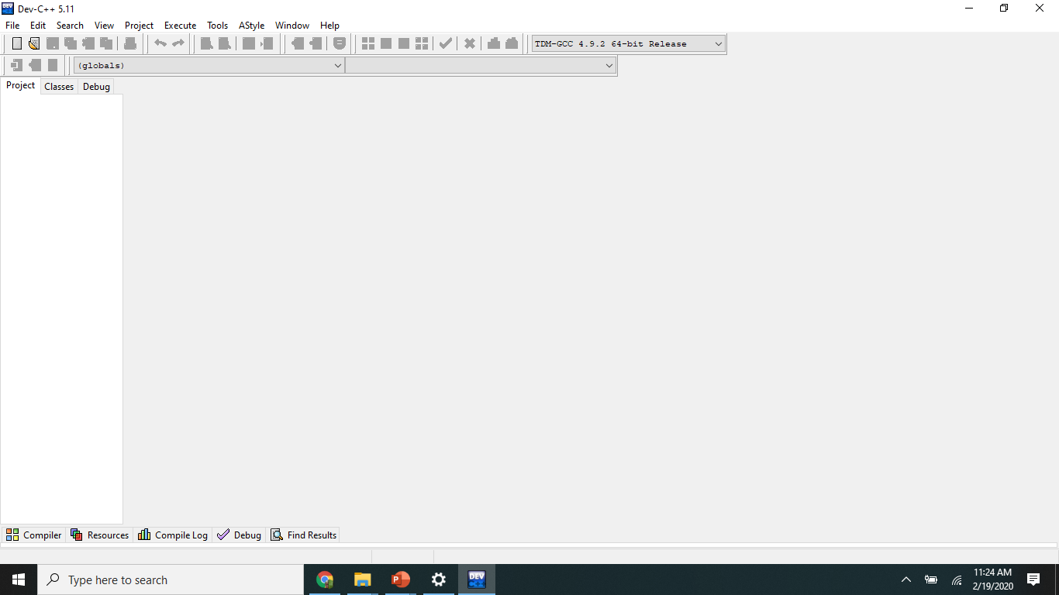
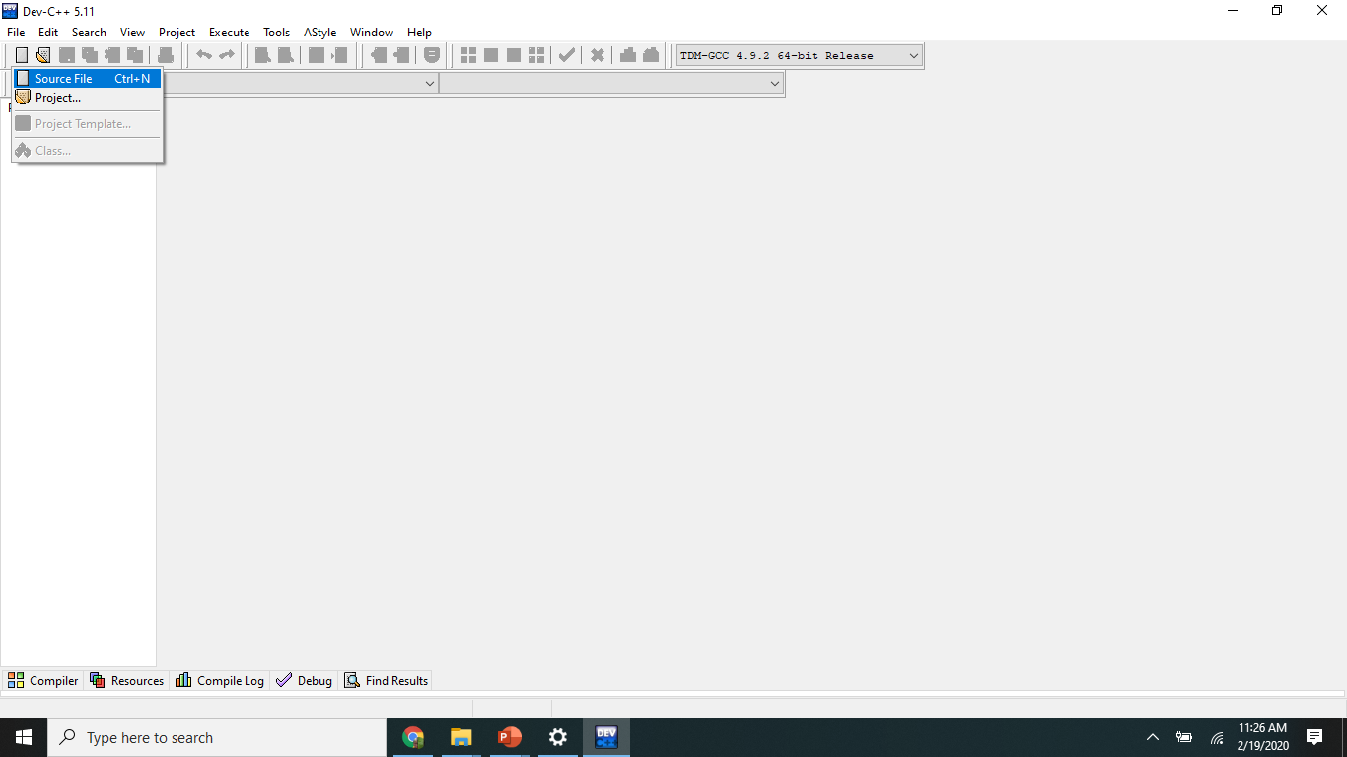
Hands On: Get to know C++ & Dev C++
Lets get started to create new file!—now click “doc symbol”
now click “source file”

Slide 12
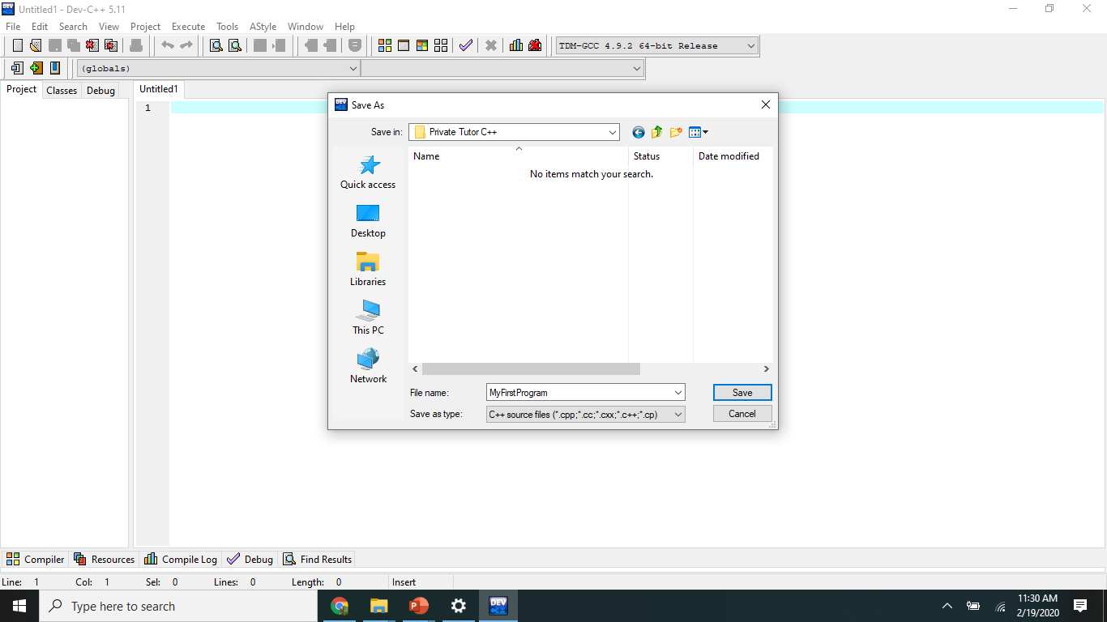
Realised something?
Extension file for c++ would be .cpp, .h, etc. but the common one is .cpp

Slide 13
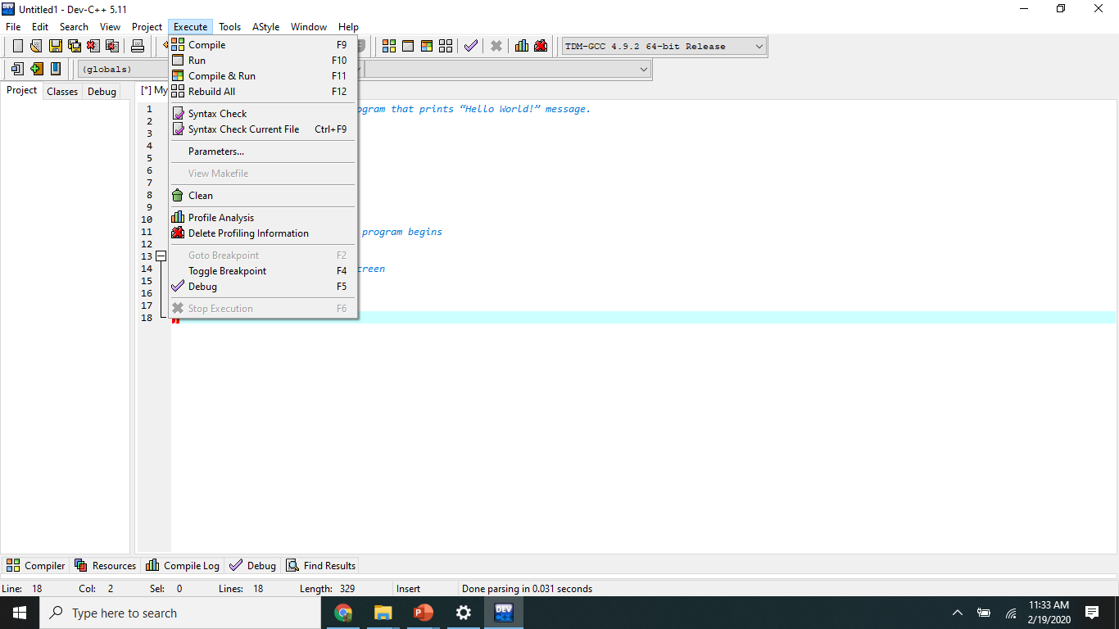
Compile – is a process of checking your program for any syntax errors or missing braces or missing semicolon etc. In simple words it checks for any grammatical errors.
Run– After compilation, a executable file is created when a program is run. executable file will not be created if the code has mistakes.
Build– usually includes one or more compile steps and once an application has been built, it can be run.

Slide 14
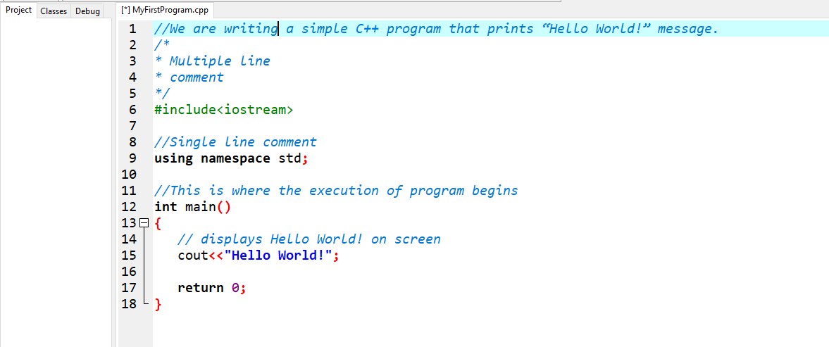
Hands On! : C++ First Program
We are writing a simple C++ program that prints “Hello World!” message.

Slide 15

So what have we learnt?
Comments – You can see two types of comments in the above program
#include<iostream> – This statements tells the compiler to include iostream file. This file contains pre defined input/output functions that we can use in our program.
using namespace std; – A namespace is like a region, where we have functions, variables etc and their scope is limited to that particular region
int main() – As the name suggests this is the main function of our program and the execution of program begins with this function
cout << “Hello World!”; – The cout object belongs to the iostream file and the purpose of this object is to display the content between double quotes as it is on the screen.
return 0; – This statement returns value 0 from the main() function which indicates that the execution of main function is successful. The value 1 represents failed execution.

Slide 16
BASICS
Basic
Variables &
their types
Data
Types
Operators
in C++

Slide 17
Variables in C++
A variable is a name which is associated with a value that can be changed. For example :
int num=20;
here variable name is num which is associated with value 20, int is a data type that represents that this variable can hold integer values.

Slide 18
Syntax of declaring a variable in C++
data_type variable1_name = value1, variable2_name = value2;
// we can write it like this
int num1=20, num2=100;
//or like this
int num1,num2;
num1=20;
num2=100;

Slide 19
HANDS ON 2: Variable

Slide 20
Types of variables
Variables can be categorised based on their data type. For example, in the above example we have seen integer types variables. Following are the types of variables available in C++.
bool: holds boolean value true or false.
double: double-precision floating point value.
float: Single-precision floating point value.

Slide 21
Types of variables
int
These type of of variables holds integer value
char
holds character value like ‘c’, ‘F’, ‘B’, ‘p’, ‘q’ etc.
Bool
holds boolean value true or false
double
double-precision floating point value.
float
Single-precision floating point value
string
contains a collection of characters surrounded by double quotes

Slide 22
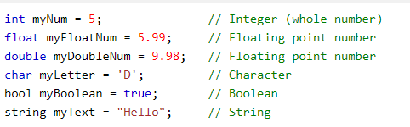
Examples

Slide 23
Types of variables based on their scope
Before going further lets discuss what is scope first. When we discussed the first c++ program, we have seen the curly braces in the program like this:
int main {
//Some code
}
Any variable declared inside these curly braces have scope limited within these curly braces, if you declare a variable in main() function and try to use that variable outside main() function then you will get compilation error.

Slide 24
Lets move on to the types of variables based on the scope.
Global variable
Local variable

Slide 25
Global Variable
A variable declared outside of any function (including main as well) is called global variable.
Global variables have their scope throughout the program, they can be accessed anywhere in the program, in the main, in the user defined function, anywhere.
Here we have a global variable myVar, that is declared outside of main. We have accessed the variable twice in the main() function without any issues.

Slide 26
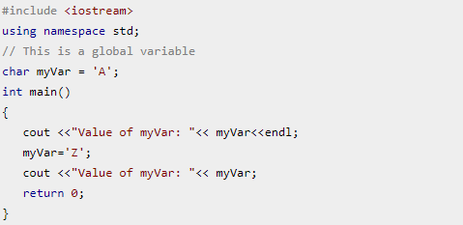
Try hands on 3: To program using global variable

Slide 27
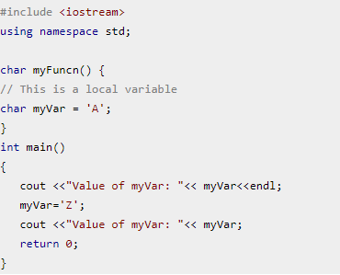
Local variable
Local variables are declared inside the braces of any user defined function.
main function, loops or any control statements(if, if-else etc) and have their scope limited inside those braces.

Slide 28
Try hands on 4: To program using Local variable

Slide 29
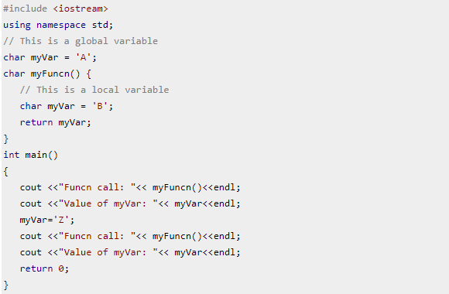
Hands On 5: Can global and local variable have same name in C++? & What is the output?

Slide 30
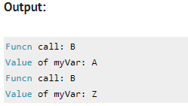
Can global and local variable have same name in C++?
As you can see that when I changed the value of myVar in the main function, it only changed the value of global variable myVar because local variable myVar scope is limited to the function myFuncn().

Slide 31
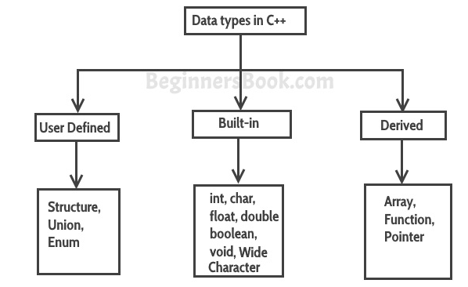
Data Types in C++
Data types define the type of data a variable can hold, for example an integer variable can hold integer data, a character type variable can hold character data etc.
Data types in C++ are categorised in three groups: Built-in, user-defined and Derived.

Slide 32
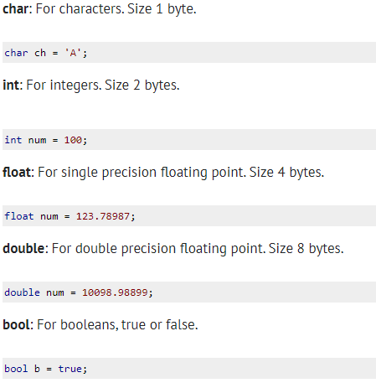
Built in data types

Slide 33
Operators in C++
Operator represents an action. For example + is an operator that represents addition. An operator works on two or more operands and produce an output.
For example 3+4+5 here + operator works on three operands and produce 12 as output.
1) Basic Arithmetic Operators 2) Assignment Operators 3) Auto-increment and Auto-decrement Operators 4) Logical Operators 5) Comparison (relational) operators 6) Bitwise Operators 7) Ternary Operator

Slide 34
Basic Arithmetic Operators
Basic arithmetic operators are: +, -, *, /, %
+ is for addition.
– is for subtraction.
* is for multiplication.
/ is for division.
% is for modulo.
Note: Modulo operator returns remainder, for example 20 % 5 would return 0

Slide 35
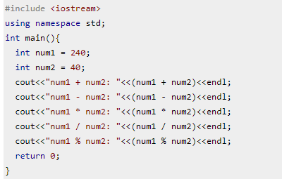
Hands On 6! :Example of Arithmetic Operators

Slide 36
Assignment Operators
Assignments operators in C++ are: =, +=, -=, *=, /=, %=
num2 = num1 would assign value of variable num1 to the variable.
num2+=num1 is equal to num2 = num2+num1
num2-=num1 is equal to num2 = num2-num1
num2*=num1 is equal to num2 = num2*num1
num2/=num1 is equal to num2 = num2/num1
num2%=num1 is equal to num2 = num2%num1

Slide 37
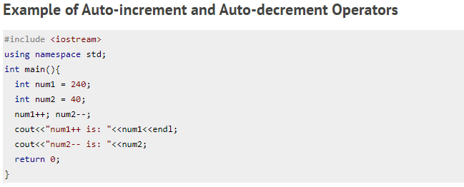
Auto-increment and Auto-decrement Operators
num++ is equivalent to num=num+1;
num– - is equivalent to num=num-1;

Slide 38
Hands On 7
Assignment Operators

Slide 39
Logical Operators
Logical Operators are used with binary variables. They are mainly used in conditional statements and loops for evaluating a condition.
Logical operators in C++ are: &&, ||, !
Let’s say we have two boolean variables b1 and b2.
b1&&b2 will return true if both b1 and b2 are true else it would return false.
b1||b2 will return false if both b1 and b2 are false else it would return true.
!b1 would return the opposite of b1, that means it would be true if b1 is false and it would return false if b1 is true.

Slide 40
Relational operators
We have six relational operators in C++: ==, !=, >, <, >=, <=
== returns true if both the left side and right side are equal
!= returns true if left side is not equal to the right side of operator.
> returns true if left side is greater than right.
< returns true if left side is less than right side.
>= returns true if left side is greater than or equal to right side.
<= returns true if left side is less than or equal to right side.

Slide 41
Bitwise Operators
There are six bitwise Operators: &, |, ^, ~, <<, >>
num1 = 11; /* equal to 00001011*/
num2 = 22; /* equal to 00010110 */

